Slide 1
DR SNSRCAS, CBE Cloud Technology Fundaments 21UCA501 II BCA “B” ODD SEM UNIT 1 Cloud Cube Model

Slide 2
The Cloud Cube Model
The Open Group maintains an association called the Jericho Forum (https://www.open group.org/jericho/index.htm) whose main focus is how to protect cloud networks. The group has an interesting model that attempts to categorize a cloud network based on four dimensional factors. As described in its paper called “Cloud Cube Model: Selecting Cloud Formations for Secure Collaboration” (http://www.opengroup.org/jericho/cloud_cube_model_
v1.0.pdf), the type of cloud networks you use dramatically changes the notion of where the boundary between the client’s network and the cloud begins and ends.

Slide 3
The Cloud Cube Model
The four dimensions of the Cloud Cube Model are shown in Figure 1.2 and listed here:
l Physical location of the data: Internal (I) / External (E) determines your organization’s boundaries.
l Ownership: Proprietary (P) / Open (O) is a measure of not only the technology ownership,
but of interoperability, ease of data transfer, and degree of vendor application lock-in.

Slide 4
The Cloud Cube Model
The four dimensions of the Cloud Cube Model are shown in Figure 1.2 and listed here:
l Physical location of the data: Internal (I) / External (E) determines your organization’s boundaries.
l Ownership: Proprietary (P) / Open (O) is a measure of not only the technology ownership,
but of interoperability, ease of data transfer, and degree of vendor application lock-in.
l Security boundary: Perimeterised (Per) / De-perimiterised (D-p) is a measure of whether
the operation is inside or outside the security boundary or network firewall.
l Sourcing: Insourced or Outsourced means whether the service is provided by the customer
or the service provider.

Slide 5
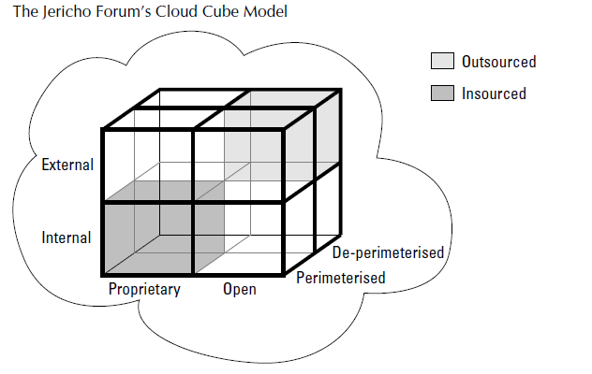
The Cloud Cube Model

Slide 6
The Cloud Cube Model
Taken together, the fourth dimension corresponds to two different states in the eight possible
cloud forms: Per (IP, IO, EP, EO) and D-p (IP, IO, EP, EO). The sourcing dimension addresses the
deliverer of the service. What the Cloud Cube Model is meant to show is that the traditional notion
of a network boundary being the network’s firewall no longer applies in cloud computing.

Slide 7
THANK YOU

